Slide 1
COPADS
2023 IFEOLUWATAYO IGE
#2b – c# and Threads

Slide 2
Thread and Multithreaded Creation (Example 1, 2)

Slide 3
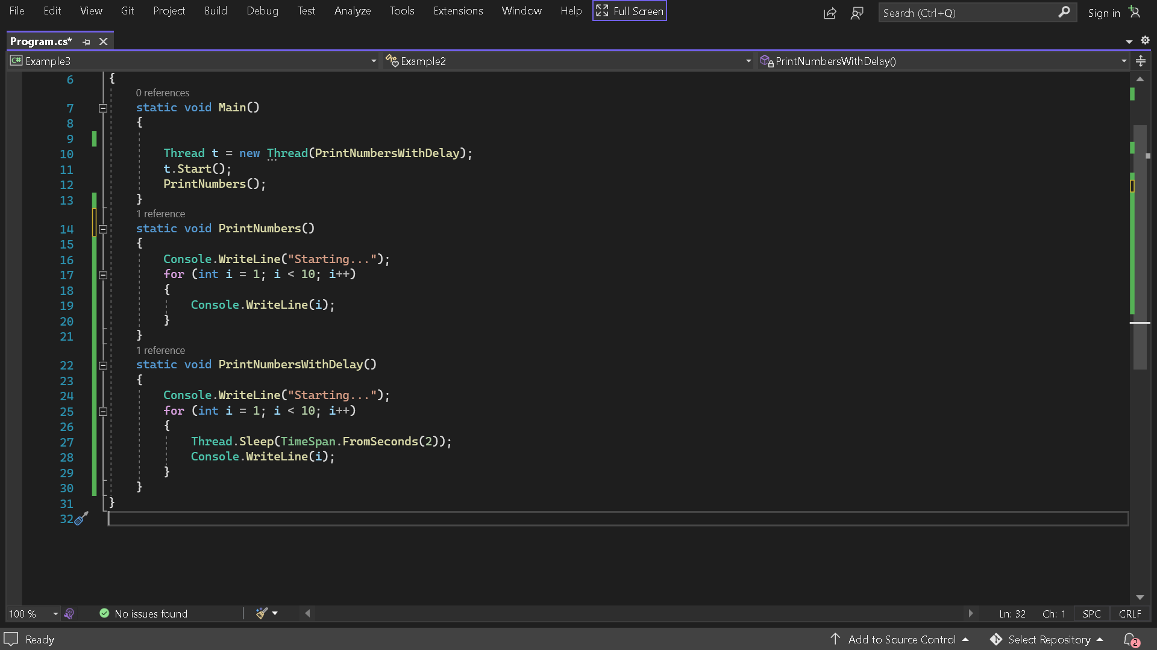
Pausing Threads: Sleep (Example 3)
While a thread is sleeping, it uses as little CPU time as possible.
The code in the PrintNumbers method that usually runs later will be executed before the code in the PrintNumbersWithDelay method in a separate thread.

Slide 4
Passing Data to Threads
We can pass arguments to a thread’s target method by executing a lambda expression that calls the method with the desired arguments:

Slide 5
Interrupts
If Interrupt is called on a thread that’s not blocked, the thread continues executing until it next blocks, at which point a ThreadInterruptedException is thrown

Slide 6
Foreground and Background Threads
A thread is always either a background thread or a foreground thread.
Background threads are identical to foreground threads with one exception: a background thread does not keep the managed execution environment running.
Once all foreground threads have been stopped in a managed process (where the .exe file is a managed assembly), the system stops all background threads and shuts down.
The Thread.IsBackground property is used to determine whether a thread is a background or a foreground thread, or to change its status.
A thread can be changed to a background thread at any time by setting its IsBackground property to true

Slide 7
Thread Pools
When a thread is created, some seconds are spent to create some fresh private local variable stack, etc
Each thread also consumes (by default) around 1 MB of memory.
The thread pool cuts these overheads by sharing and recycling threads, allowing multithreading to be applied at a very granular level without a performance penalty.
The Thread pool comprises of Worker threads waiting for task allocation to improve concurrent allocation
Thread-Pool pattern states, the work items are queued and the free threads in thread pool takes one from this queue.
No creation or disposal overhead as work is assigned to existing threads
It limits the amount of threads that can be created so that the system is not overloaded with many running threads.
Too many active threads throttle the operating system with the ‘administrative burden’ and render CPU caches ineffective.
Thread pools are typically used for many short tasks in a server environment (db connections)

Slide 8
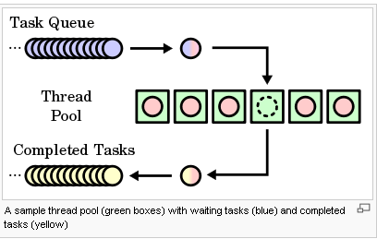
TASKS
Instead of creating new threads, why not just have a thread pool and assign tasks to available threads from a thread pool?
We should never create a new thread every time we need to execute a “task” because thread initialization and disposal are expensive activities for the OS
When the application starts, the thread pool contains no threads.
Threads are created on-demand only when the application needs them.
After the thread completes, it is not destroyed, unless it remains inactive for too much time(relative).
Instead, it returns to the thread pool in a suspended state and is awakened whenever necessary.

Slide 9
NET framework provides Threading.Tasks class in the Task Parallel Library (or TPL), to let you create tasks and run them asynchronously
a Task represents an asynchronous operation. It represents some work that should be done
Most times, it returns a result.
It is advisable to use tasks instead of threads.
A task will by default use the Threadpool, which saves resources as creating multiple threads can be expensive.
When can I use Threads instead of Tasks:
When we need a foreground execution of some code.
Tasks always run on background threads which do not block the application from exiting.
When we want a thread to have some particular priority.
Implementing a Task scheduler isn’t always worth it, that’s why a new thread is usually the best option

Slide 10
Parallel.For and Parallel.ForEach
Parallel.For loop executes iterations that may run in parallel. You can monitor and even manipulate the state of the loop.
is just like the for loop except it allows the iterations to run in parallel across multiple threads.
The Parallel. ForEach loop partitions the source collection and schedules the work on multiple threads based on the system environment.
The more processors on the system, the faster the parallel method runs.
Parallel.For(<start>, <end>, <item>=>{anonymous method})
Parallel.ForEach(<collection>, <item>=>{anonymous method})

